Slide 1



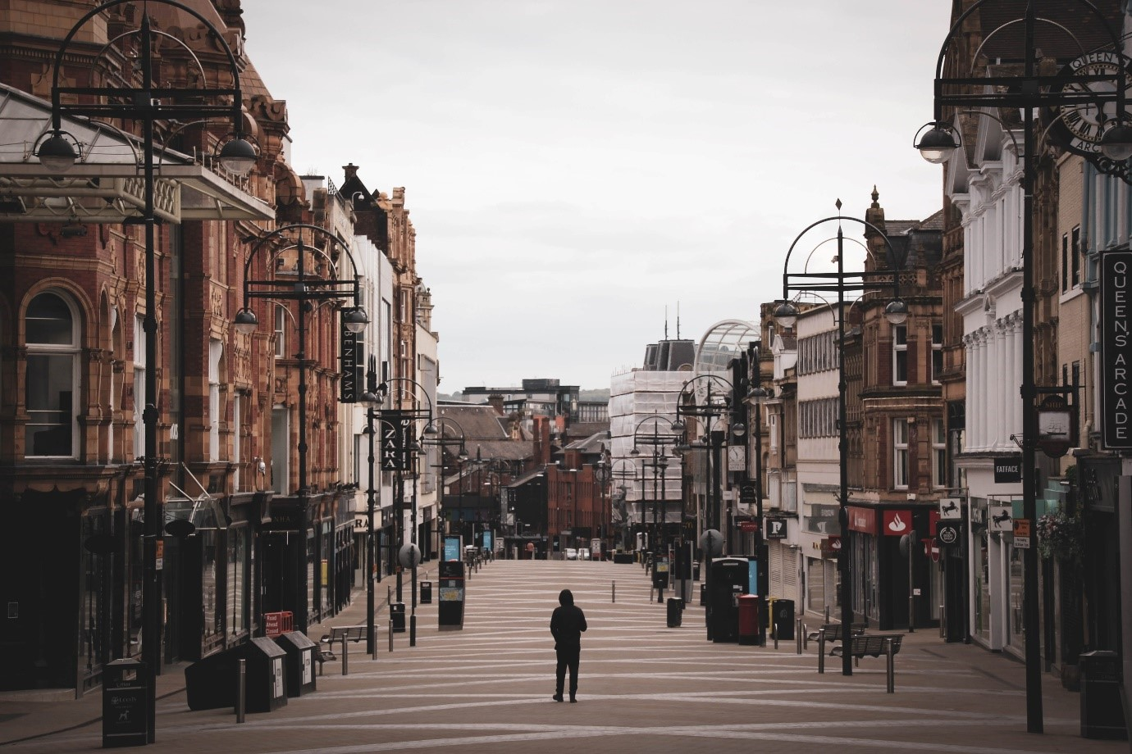
Modelling Ambient Populations under Different Restriction Schemes
Indumini Ranatunga | Dr Patricia Ternes Dallagnollo | Dr Victoria Houlden | Dr Nicolas Malleson

Slide 2
Modelling Ambient Populations under Different Restriction Schemes / Reasons
How have cities changed during the pandemic?
Which changes will remain as the pandemic subsides?
Indumini Ranatunga | Dr Patricia Ternes Dallagnollo | Dr Victoria Houlden | Dr Nicolas Malleson
Notes:
Reason:
Pandemic
Leeds City Council

Slide 3
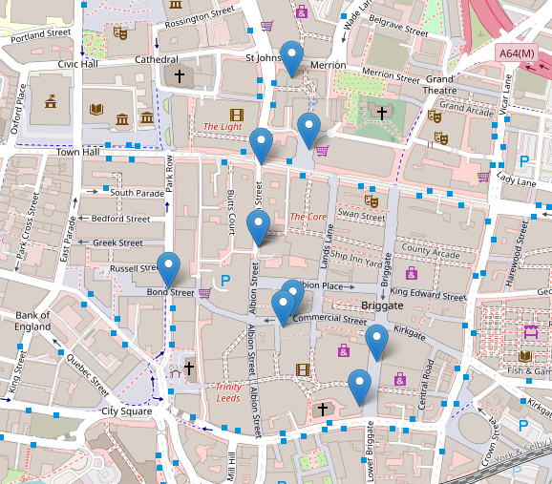
Modelling Ambient Populations under Different Restriction Schemes / Data
Data
10 cameras locations around Leeds City Centre.
793,558 filtered hourly counts from 2008 to 2021.
Raw data from Data Mill North
Cleaned and aggregated by the Data Scientist Tom Albone for previous CDRC funded LIDA Data Science Project: Leeds City Council Ambient Pop under COVID-19
Indumini Ranatunga | Dr Patricia Ternes Dallagnollo | Dr Victoria Houlden | Dr Nicolas Malleson

Slide 4
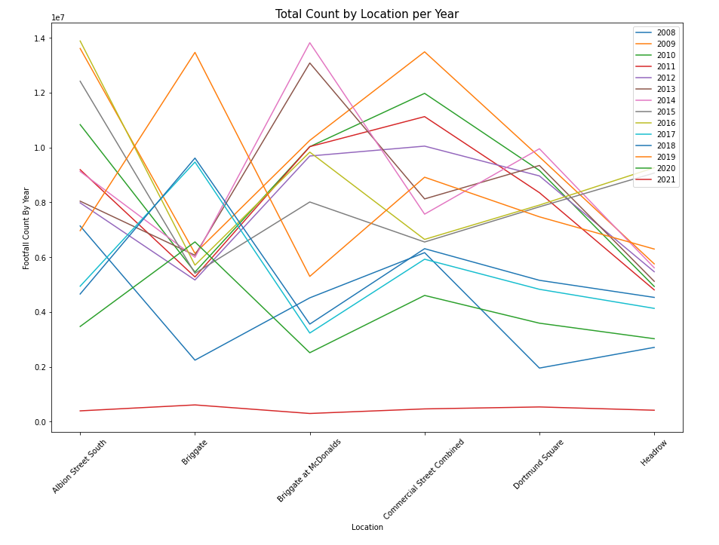


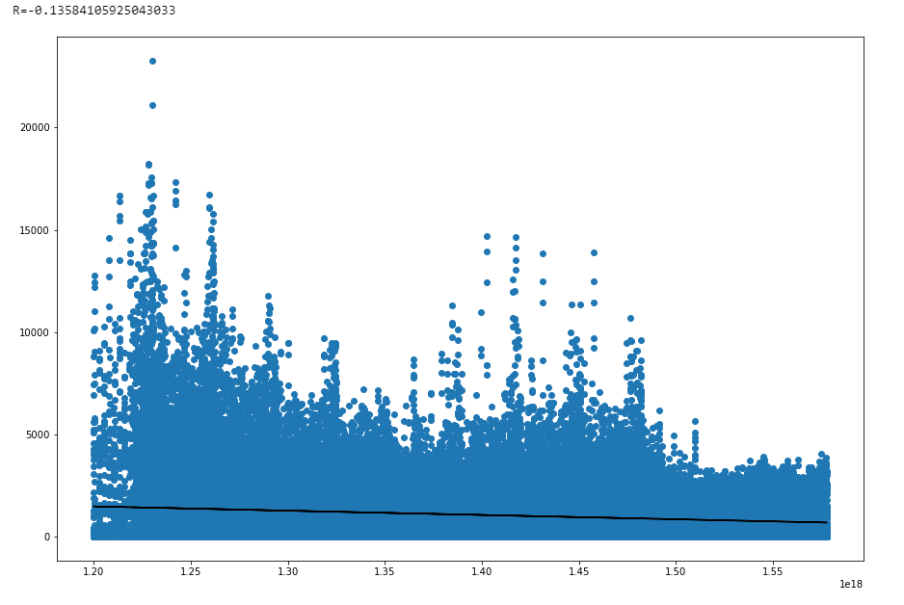
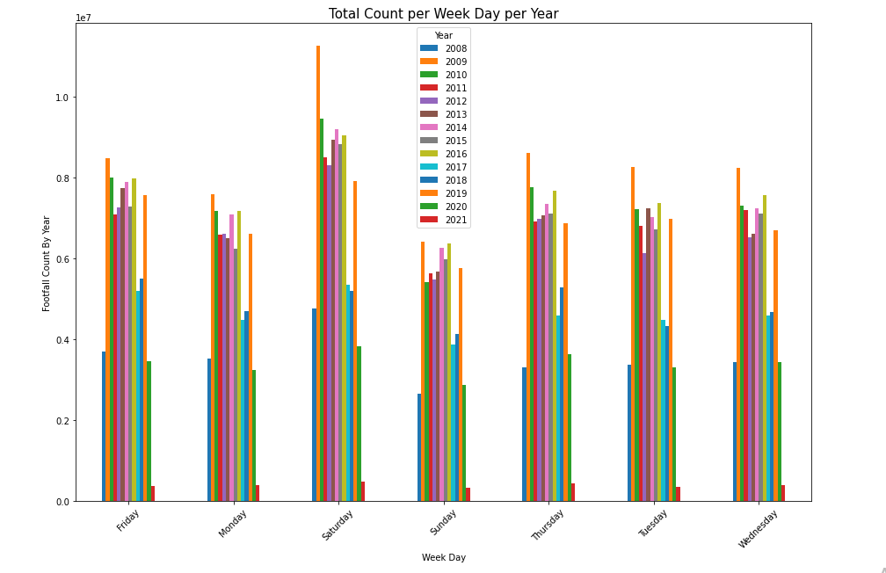
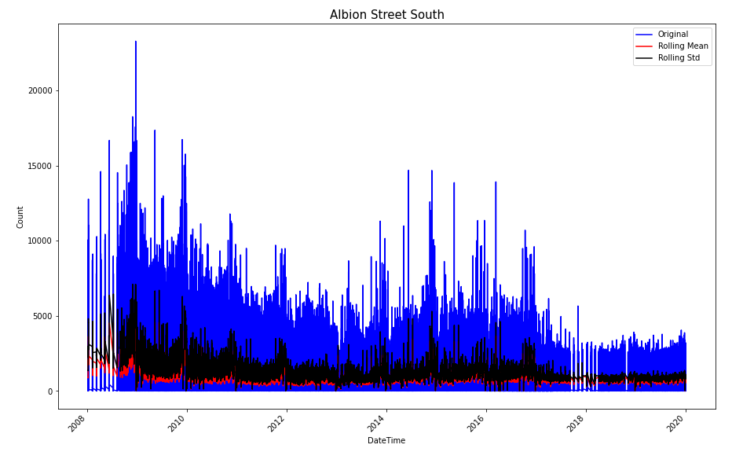
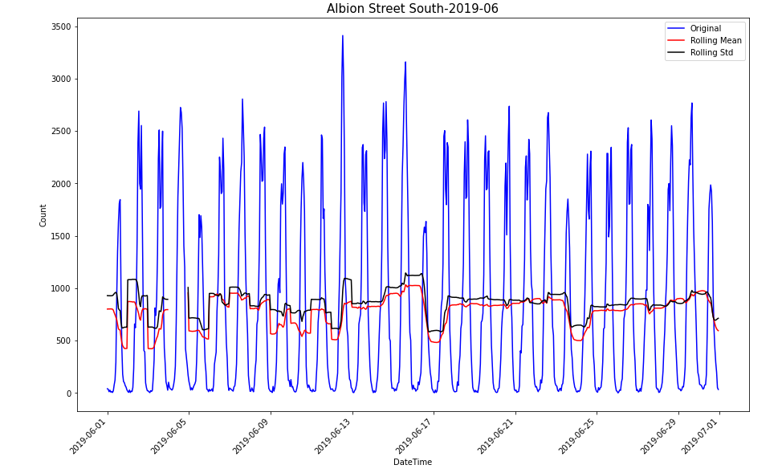
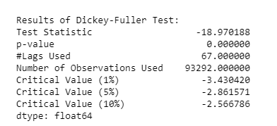
Modelling Ambient Populations under Different Restriction Schemes / Current Work
CURRENT WORK
Studying Previous LIDA Data Science Project work: Analysis and Random Forests
EDA and Testing other methods:
Linear Regression
Time Series Analysis and Forecasting – ARIMA, SARIMA
Reading and brushing up on Data Science topics
Indumini Ranatunga | Dr Patricia Ternes Dallagnollo | Dr Victoria Houlden | Dr Nicolas Malleson
Notes:
Elaborate on each topic

Slide 5


Modelling Ambient Populations under Different Restriction Schemes / Next Steps
Next Steps
Training the footfall counts during pre pandemic years with the best possible method
Pit and compare the projections with the data different restriction schemes
Create a dashboard prototype for visualising the model with i.e. interactive maps
Indumini Ranatunga | Dr Patricia Ternes Dallagnollo | Dr Victoria Houlden | Dr Nicolas Malleson

Slide 6
Modelling Ambient Populations under Different Restriction Schemes / Next Steps
Future Plans
Procure funding to expand the model to take in footfalls from different cities, then regions and to a national scale
Indumini Ranatunga | Dr Patricia Ternes Dallagnollo | Dr Victoria Houlden | Dr Nicolas Malleson

Slide 7
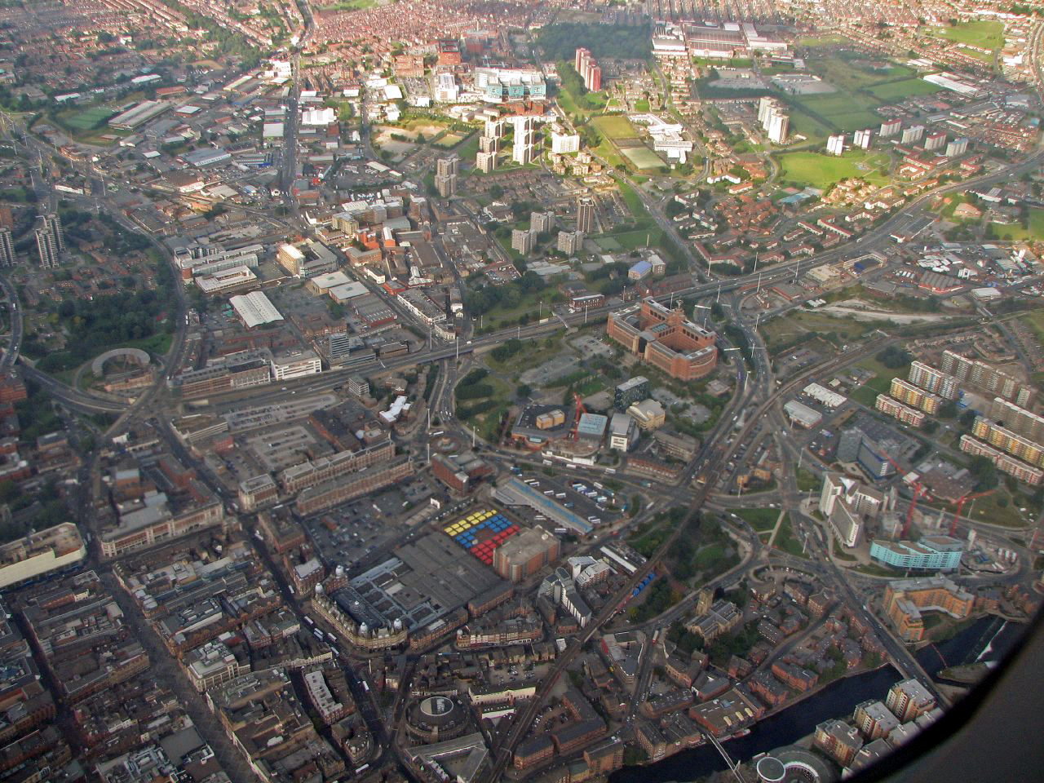
Thank you…
Indumini Ranatunga | Dr Patricia Ternes Dallagnollo | Dr Victoria Houlden | Dr Nicolas Malleson

